Slide 1
AGRICULTURE CROP YIELD
PREPARED BY : MANPREET KAUR

Slide 2
INTRODUCTION
Agriculture is a major contributor to the economy.
Crop yield depends on rainfall, fertilizer usage, pesticides, cultivated area, and season.
Data analytics helps improve agricultural planning and productivity.
# This project focuses on analysing agriculture crop yield data using data cleaning techniques and dashboard visualization to identify patterns, compare crop performance, and support better decision-making for farmers, researchers, and policymakers.

Slide 3
OBJECTIVES
Analyse factors affecting crop yield.
Identify high-yield and low-yield crops.
Study the impact of rainfall, fertilizer, and pesticide use.
Build an interactive dashboard for decision making.

Slide 4
DATASET OVERVIEW
Attribute | Description
Crop | Name of crop
Crop Year | Year of cultivation
Season | Growing season
State | State where crop was grown
Area | Cultivated area
Production | Total production
Annual Rainfall | Rainfall received
Fertilizer | Fertilizer usage
Pesticide | Pesticide usage
Yield | Crop yield
* Total Records: 19,689 * Total Columns: 10

Slide 5
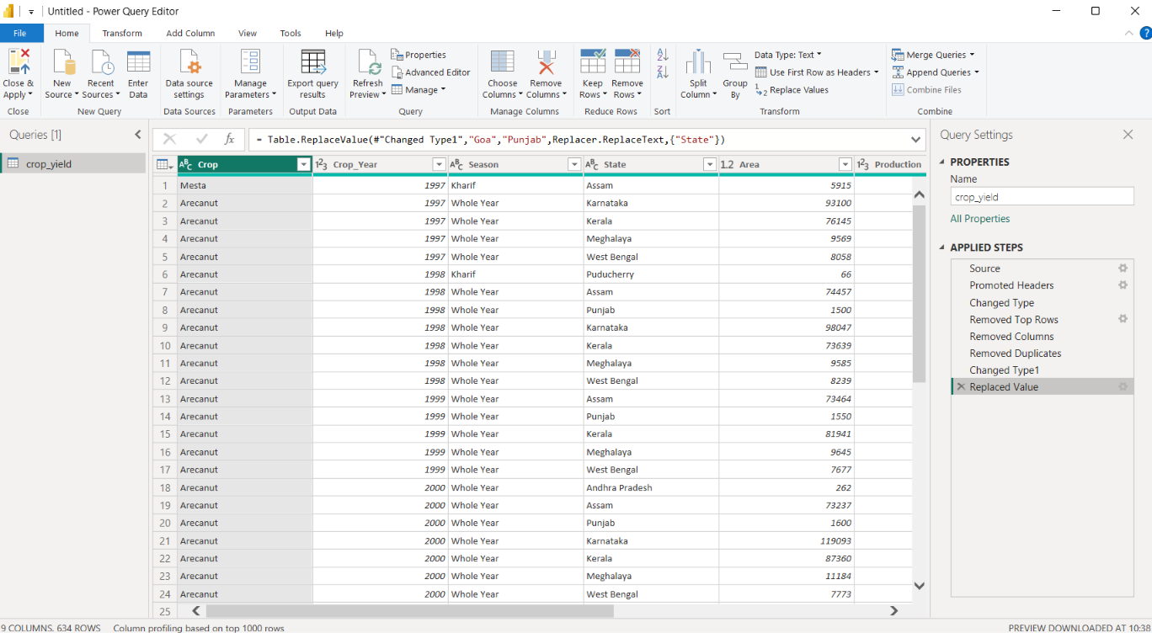
DATA CLEANING
STEP 1: Removed the First 10 Top Rows from the column Pesticides
STEP 2: Removed the column Pesticides
STEP 3: Removed Duplicates from the column Area
STEP 4: Change the type of value from Whole number to Text
STEP 5: Replace the value in State column from Goa to Punjab

Slide 6
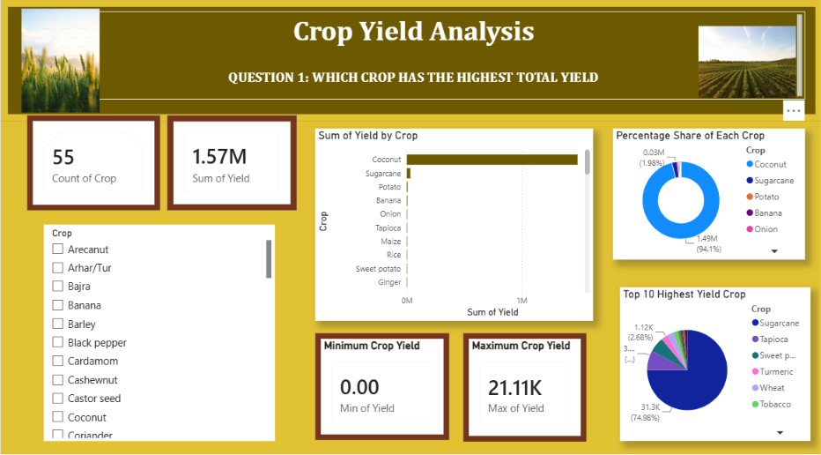
DASHBOARD QUESTION 1
. This Question represents that which crop has highest yield.
. Basically , It consist of
Bar chart
Pie chart
Donut Chart
Slicers
Cards
. Count of Crop is 55
. Sum of Yield is 1.57M

Slide 7
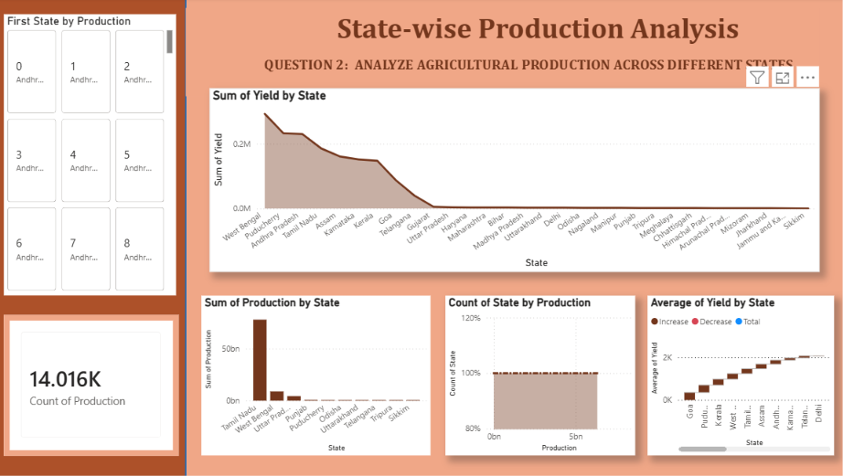
QUESTION 2
. This Question represents the Production across different States
. It consist of
Stacked Area chart
Waterfall chart
Clustered Column chart
Card
Button Slicer
. Count of Production is 14.016K

Slide 8
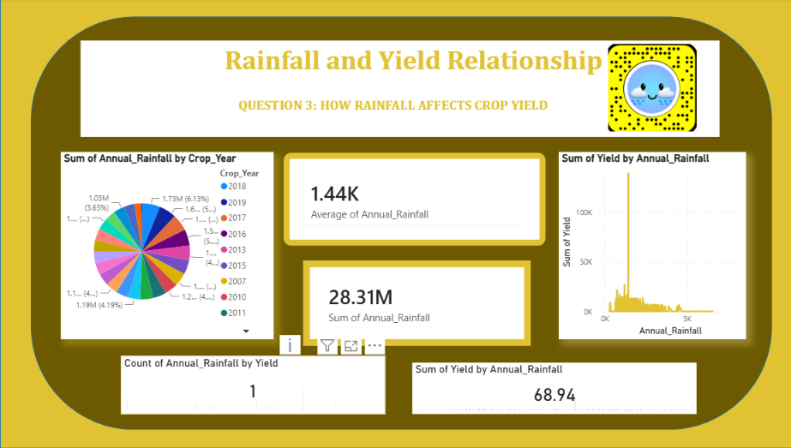
QUESTION 3
. This Question represents how rainfall affects the Crop Yield
. It consist of
Pie chart
Area chart
KPI Cards
Cards
. Average annual rainfall is 1.44K
. Sum of annual rainfall is 28.31M

Slide 9
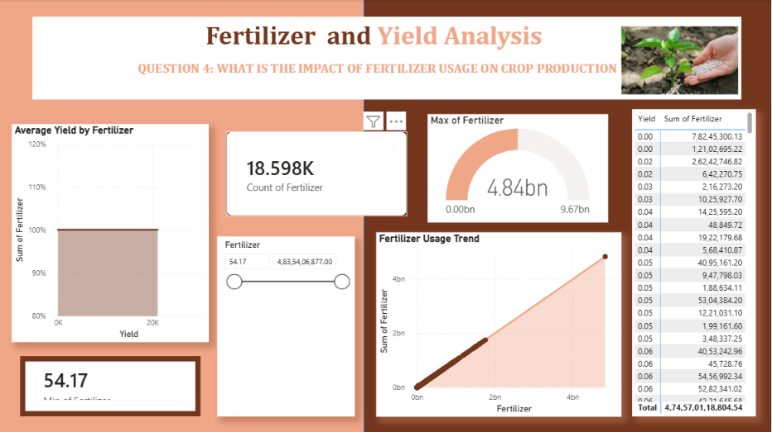
QUESTION 4
. This Question represents the impact of Fertilizer usage on Crop Production
. It consist of
Stacked Area chart
Area chart
Gauge
Cards
Slicer
. Minimum of Fertilizer is 54.17
. Count of Fertilizer is 18.598K

Slide 10
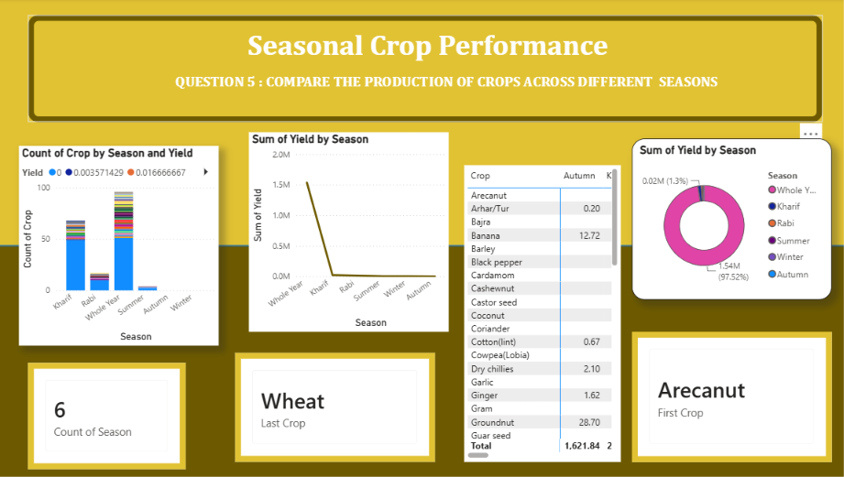
QUESTION 5
.This Question represents the comparison of Production of Crops across different Seasons
. It consist of
Stacked Column chart
Line chart
Pie chart
Matrix
. First crop is Arecanut
. Last crop is Wheat
. Count of Season is 6

Slide 11
KEY INSIGHTS
Coconut, Sugarcane, and Banana recorded the highest average crop yields.
Coconut, Rice, and Wheat were among the largest contributors to total production.
Kerala, Tamil Nadu, and Karnataka showed the highest production levels.
Whole Year crops contributed more production than seasonal crops.
Larger cultivated areas generally resulted in higher production.
Rainfall, fertilizer, and pesticide usage significantly influenced crop yield.
Agricultural productivity varied across states and seasons.
Data visualization helped identify trends and support better agricultural decision-making.

Slide 12
CONCLUSION
Data cleaning improved data quality and reliability.
The dashboard provides interactive insights for agricultural planning.
Farmers and policymakers can use these insights for better decision-making.

Slide 13


